Slide 1



Slide 2

AGENDA
Introduction
Data Model v.2
The OSS Effect (Storyboard)
The Initial Development
OPTIMAL SOFTWARE SOLUTIONS

Slide 3
AGENDA
Introduction
Introduction
Data Model v.2
The OSS Effect (Storyboard)
The Initial Development
Project: OSS-NCR
Presentation Content: Data Model Revision and Insight of NCR process.

Slide 4
Data model v.1
DOCUMENT
docNum*
docTitle
docAuthor
docDate
docRevisionDate
docRevisionNum
NCRLOG
ncrLogNum*
ncrLogDate
ncrLogStatus
AGENDA
>
Introduction
>
>
Introduction
Data Model v.2
The OSS Effect (Storyboard)
The Initial Development
Project: OSS-NCR
Presentation Content: Data Model Revision and Insight of NCR process.
>
SUPPLIER
supplierID*
supplierName
ncrLogNum#
QUALITYREP
qualityRepID*
qualityRepName
qualityRepSignDate
>
>
PRODUCT
productNum*
productDefectDescription
productSaleOrderNumber
productQuantityReceived
productQuantityDefective
supplierID#
NCRFORM
ncrFormNum*
ncrFormDate
ncrFormConfirm
ncrFormIdentifyProcess
productNum#
qualityRepID#
ncrLogNum#
docNum#

Slide 5
SALE
saleID*
salesOrderReceiptNum
>
Data model v.1
REVISION
revID*
revNum
revDate
revUpdate
ncrID#
NCRFORM
ncrFormNum*
ncrFormDate
ncrFormConfirm
ncrFormIdentifyProcess
productNum#
qualityRepID#
ncrLogNum#
docNum#
REVISIONLOG
revLogID*
revID#
>
DOCUMENT
docNum*
docTitle
docAuthor
docDate
docRevisionDate
docRevisionNum
NCRLOG
ncrLogNum*
ncrLogDate
ncrLogStatus
REVIEWENGINEER
reviewEngID*
reviewDisposition
reviewCustUpdate
engInsID#
>
>
NCRENGINEERINSPECTOR
engInspID*
engDisposition
>
PRODUCT_ORDER
orderID*
orderProductNo
orderProductQuantity
prodID#
saleID#
PRODUCT
prodID*
prodNo
prodDescription
supplierID#
>
ROLE
roleID*
roleType
>
>
PRODUCT
productNum*
productDefectDescription
productSaleOrderNumber
productQuantityReceived
productQuantityDefective
supplierID#
>
SUPPLIER
supplierID*
supplierName
ncrLogNum#
QUALITYREP
qualityRepID*
qualityRepName
qualityRepSignDate
>
>
ROLEINCHARGE
roleChargeID*
roleID#
>
>
>
EMPLOYEEINCHARGE
empChargeID*
empSign
empSignDate
empID#
ncrID#
Project: OSS-NCR
Presentation Content: Data Model Revision and Insight of NCR process.
Introduction

Slide 6

Data model v. 2
REVISION
revID*
revNum
revDate
revUpdate
ncrID#
REVISIONLOG
revLogID*
revID#
>
REVIEWENGINEER
reviewEngID*
reviewDisposition
reviewCustUpdate
engInsID#
SALE
saleID*
salesOrderReceiptNum
NCRENGINEERINSPECTOR
engInspID*
engDisposition
>
NCR
ncrID*
ncrDate
ncrLogNumber
ncrActive
orderID#
PRODUCT_ORDER
orderID*
orderProductNo
orderProductQuantity
prodID#
saleID#
PRODUCT
prodID*
prodNo
prodDescription
supplierID#
ROLE
roleID*
roleType
>
>
>
>
NCRQUALITYREP
qRepID*
ncrFormConfirm
ncrIdentityProcess
ncrDefectDescription
ncrQuantityDefective
ncrID#
EMPLOYEEINCHARGE
empChargeID*
empSign
empSignDate
empID#
ncrID#
>
EMPLOYEE
empID*
empName
roleID
>
SUPPLIER
supplierID*
supplierName
ncrLogNum#
ROLEINCHARGE
roleChargeID*
roleID#
Project: OSS-NCR
Presentation Content: Data Model Revision and Insight of NCR process.
Introduction

Slide 7


Data model v. 2
REVISION
revID*
revNum
revDate
revUpdate
ncrID#
REVISIONLOG
revLogID*
revID#
>
ROLE
SALE
saleID*
salesOrderReceiptNum
REVIEWENGINEER
reviewEngID*
reviewDisposition
reviewCustUpdate
engInsID#
NCRENGINEERINSPECTOR
engInspID*
engDisposition
>
PRODUCT_ORDER
orderID*
orderProductNo
orderProductQuantity
prodID#
saleID#
PRODUCT
prodID*
prodNo
prodDescription
supplierID#
ROLE
roleID*
roleType
>
ALEX ARMANI
>
CROSSFIRE EMPLOYEE
QUALITY Rep
>
>
EMPLOYEE
empID*
empName
roleID
ROLEINCHARGE
roleChargeID*
roleID#
NCRQUALITYREP
qRepID*
ncrFormConfirm
ncrIdentityProcess
ncrDefectDescription
ncrQuantityDefective
ncrID#
NCR
ncrID*
ncrDate
ncrLogNumber
ncrActive
orderID#
>
>
SUPPLIER
supplierID*
supplierName
ncrLogNum#
EMPLOYEEINCHARGE
empChargeID*
empSign
empSignDate
empID#
ncrID#
Project: OSS-NCR
Presentation Content: Data Model Revision and Insight of NCR process.
Introduction

Slide 8
Data model v. 2
REVISION
revID*
revNum
revDate
revUpdate
ncrID#
REVISIONLOG
revLogID*
revID#
>
ROLE
SALE
saleID*
salesOrderReceiptNum
REVIEWENGINEER
reviewEngID*
reviewDisposition
reviewCustUpdate
engInsID#
NCRENGINEERINSPECTOR
engInspID*
engDisposition
>
PRODUCT_ORDER
orderID*
orderProductNo
orderProductQuantity
prodID#
saleID#
PRODUCT
prodID*
prodNo
prodDescription
supplierID#
ROLE
roleID*
roleType
>
ALEX ARMANI
>
CROSSFIRE EMPLOYEE
QUALITY Rep
>
>
EMPLOYEE
empID*
empName
roleID
ROLEINCHARGE
roleChargeID*
roleID#
NCRQUALITYREP
qRepID*
ncrFormConfirm
ncrIdentityProcess
ncrDefectDescription
ncrQuantityDefective
ncrID#
NCR
ncrID*
ncrDate
ncrLogNumber
ncrActive
orderID#
>
>
SUPPLIER
supplierID*
supplierName
ncrLogNum#
EMPLOYEEINCHARGE
empChargeID*
empSign
empSignDate
empID#
ncrID#
Project: OSS-NCR
Presentation Content: Data Model Revision and Insight of NCR process.
Introduction

Slide 9
Data model v. 2
Data model v. 2
REVISION
revID*
revNum
revDate
revUpdate
ncrID#
REVISIONLOG
revLogID*
revID#
>
ROLE
SALE
saleID*
salesOrderReceiptNum
REVIEWENGINEER
reviewEngID*
reviewDisposition
reviewCustUpdate
engInsID#
NCRENGINEERINSPECTOR
engInspID*
engDisposition
>
PRODUCT_ORDER
orderID*
orderProductNo
orderProductQuantity
prodID#
saleID#
PRODUCT
prodID*
prodNo
prodDescription
supplierID#
ROLE
roleID*
roleType
>
ALEX ARMANI
>
CROSSFIRE EMPLOYEE
QUALITY Rep
>
>
EMPLOYEE
empID*
empName
roleID
ROLEINCHARGE
roleChargeID*
roleID#
NCRQUALITYREP
qRepID*
ncrFormConfirm
ncrIdentityProcess
ncrDefectDescription
ncrQuantityDefective
ncrID#
NCR
ncrID*
ncrDate
ncrLogNumber
ncrActive
orderID#
>
>
SUPPLIER
supplierID*
supplierName
ncrLogNum#
EMPLOYEEINCHARGE
empChargeID*
empSign
empSignDate
empID#
ncrID#
Project: OSS-NCR
Presentation Content: Data Model Revision and Insight of NCR process.
Introduction

Slide 10
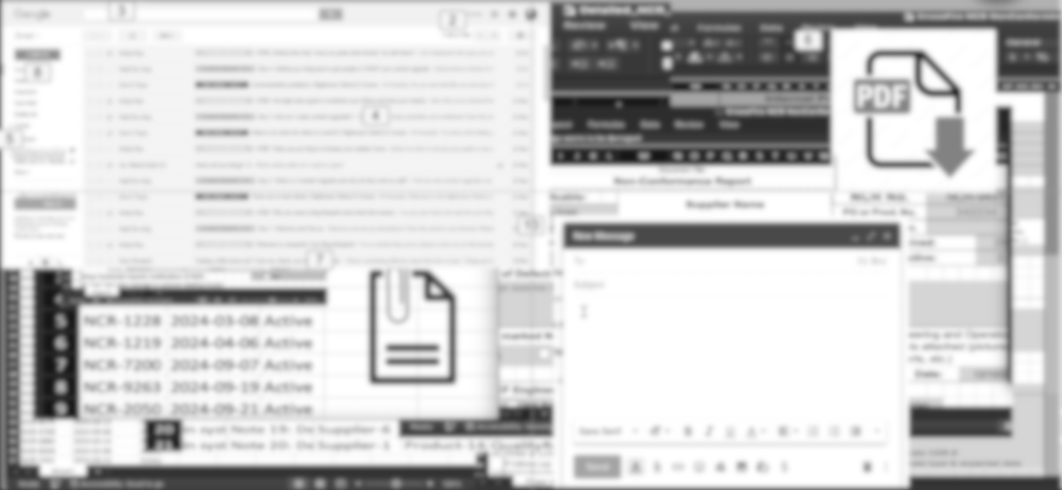
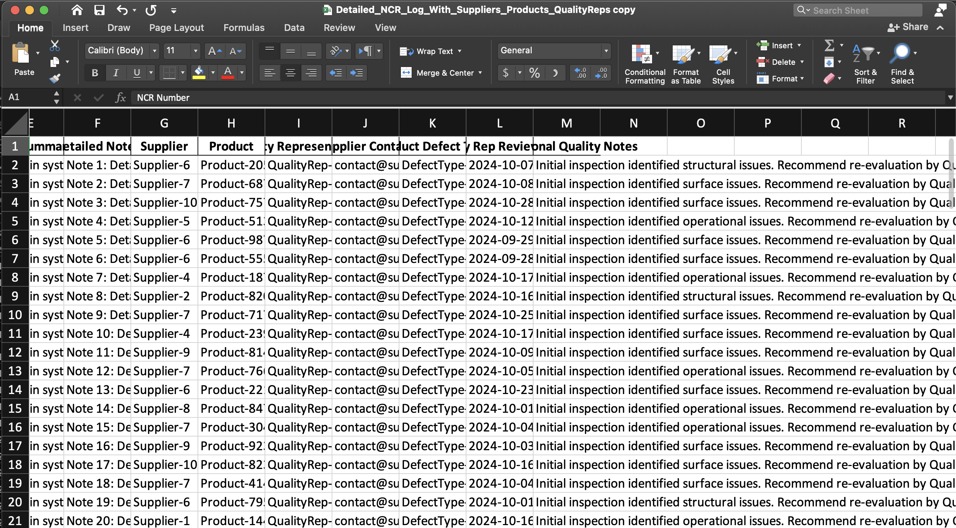
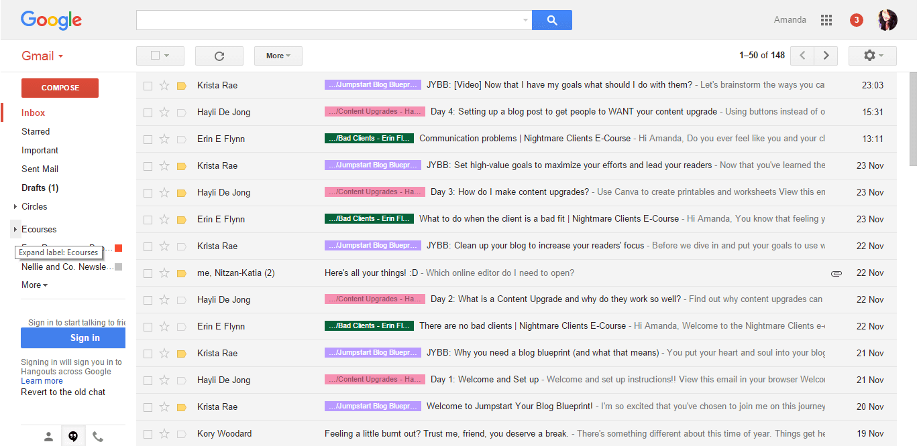
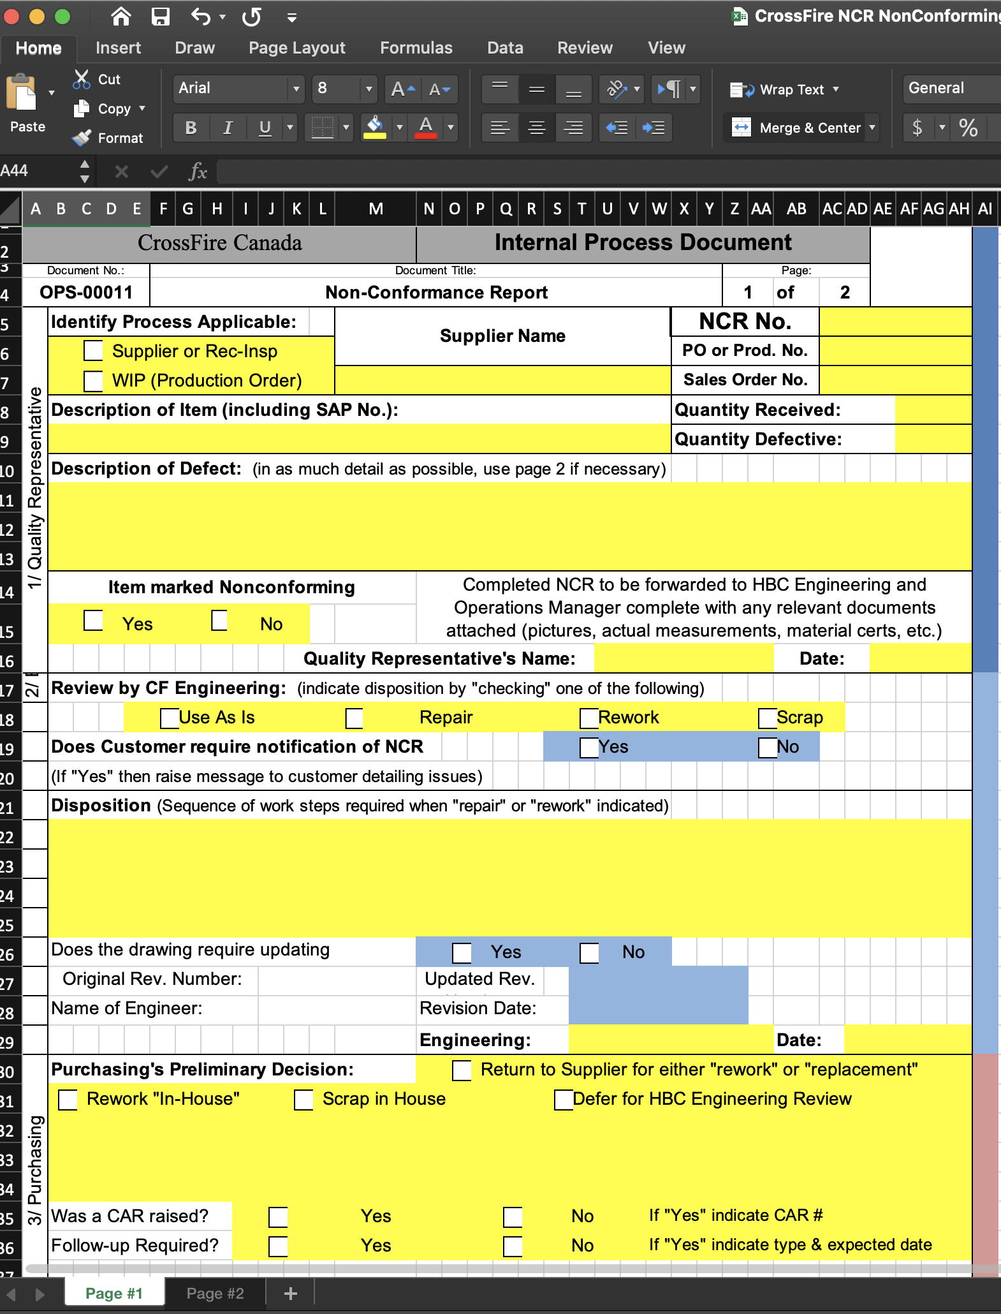
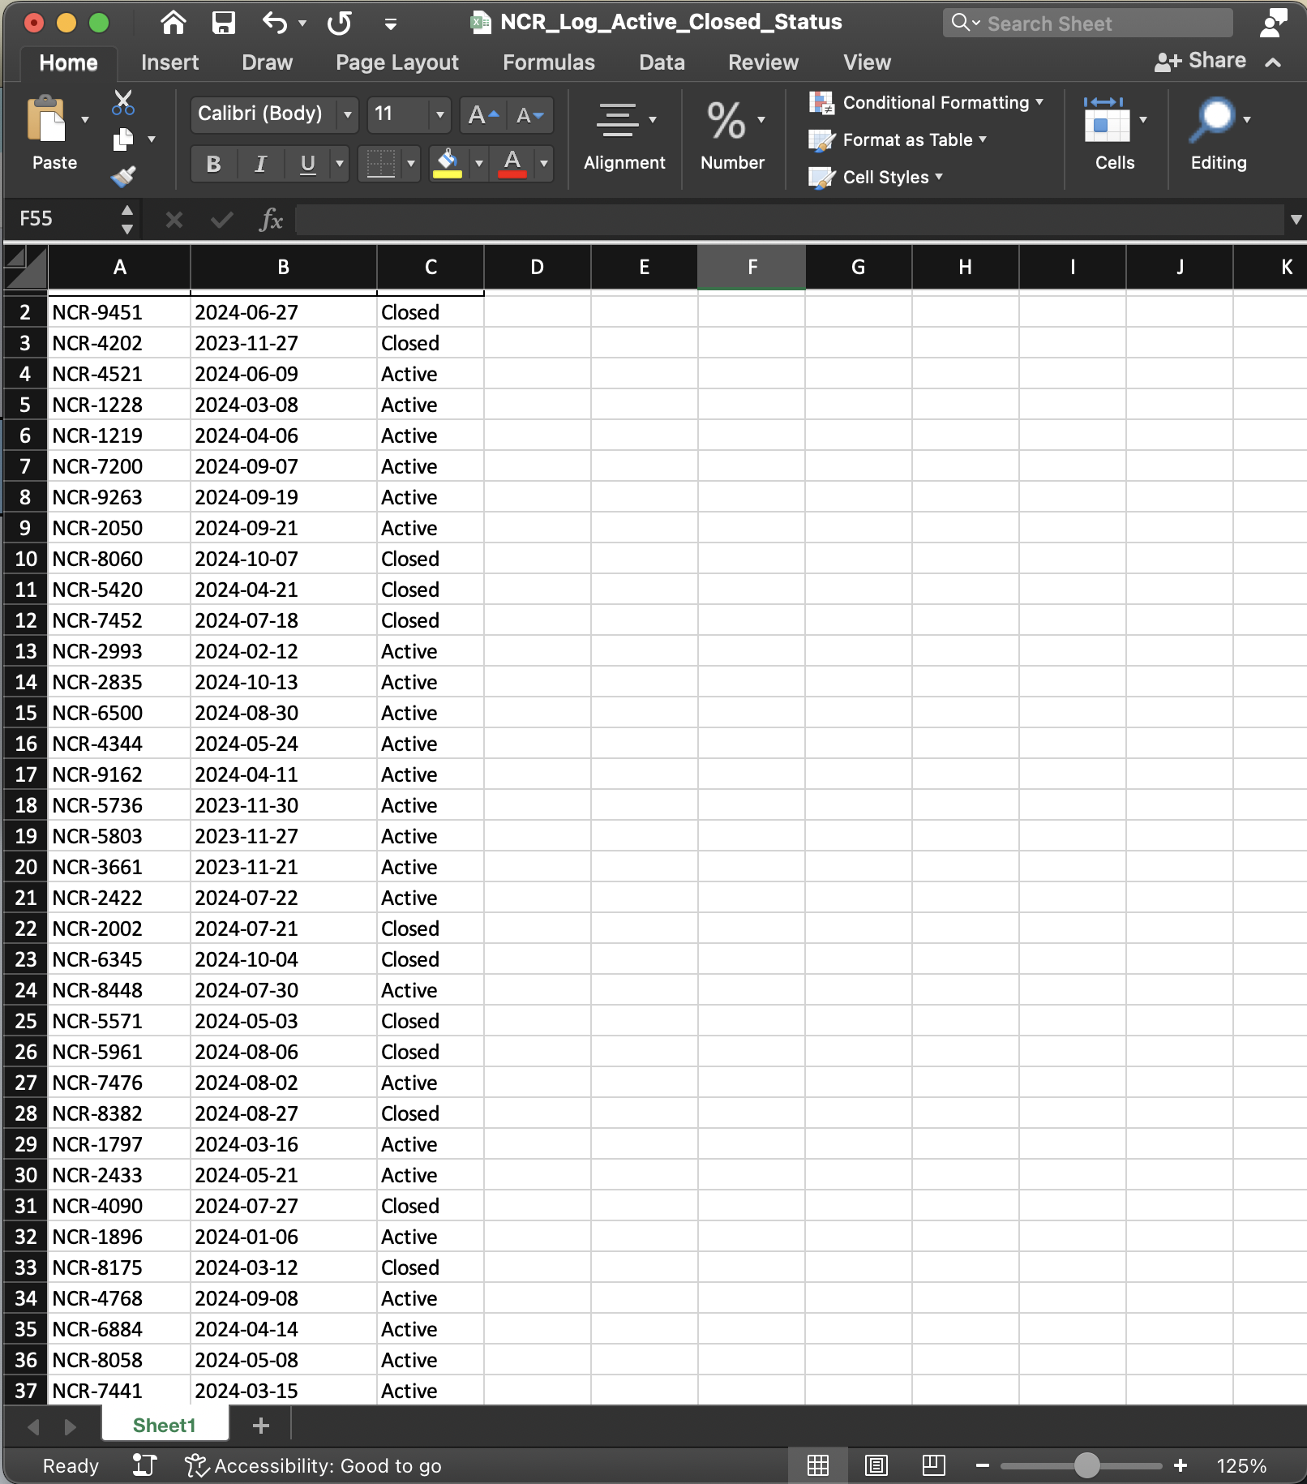

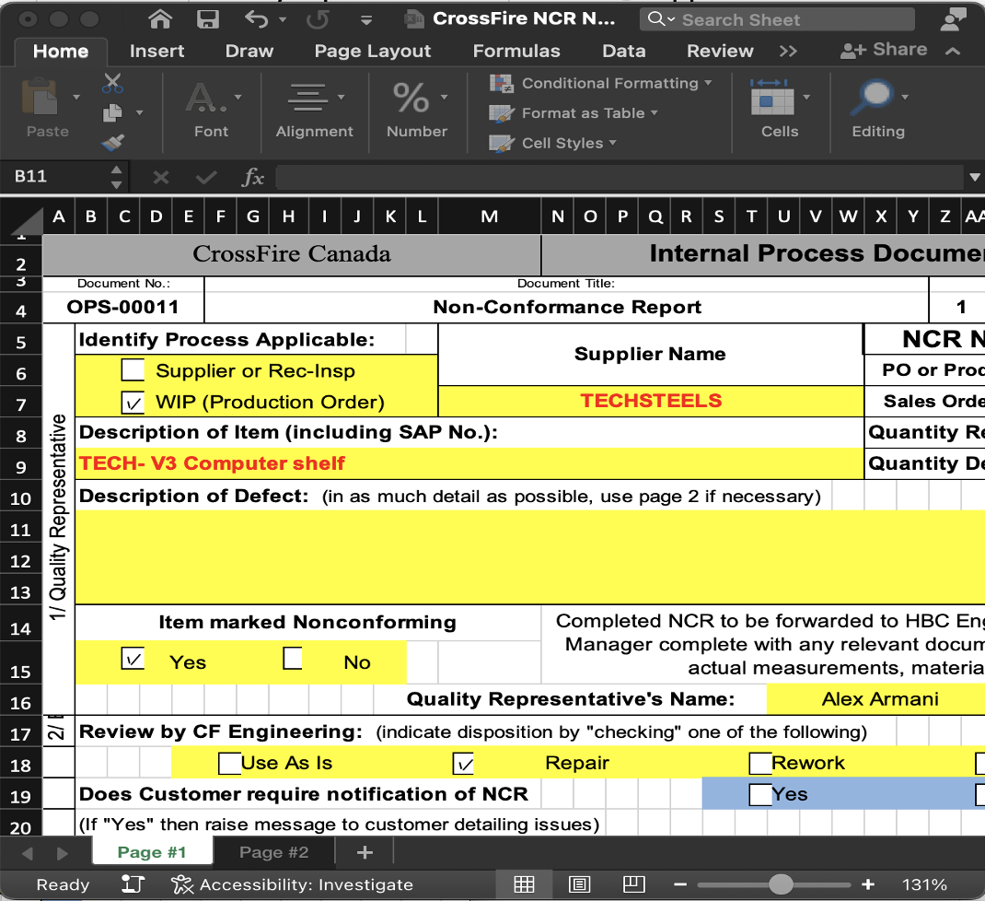

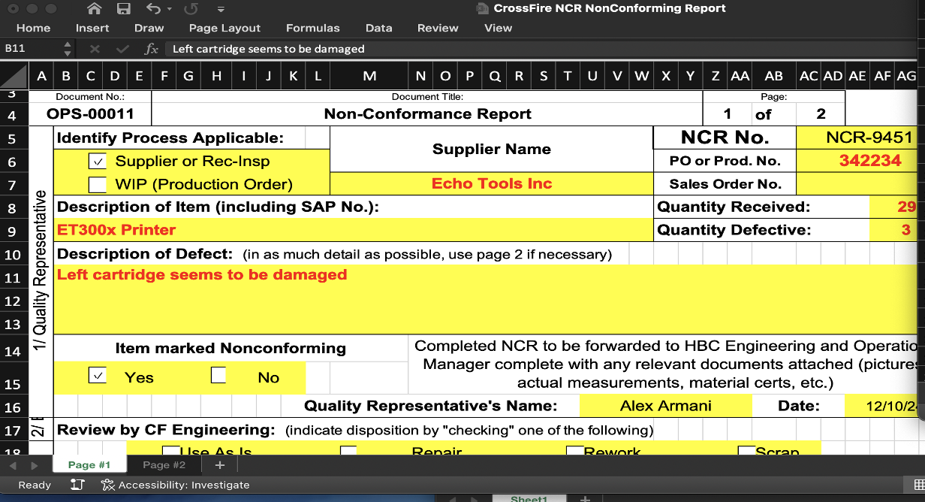
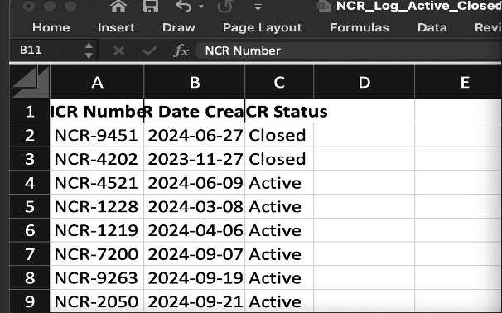
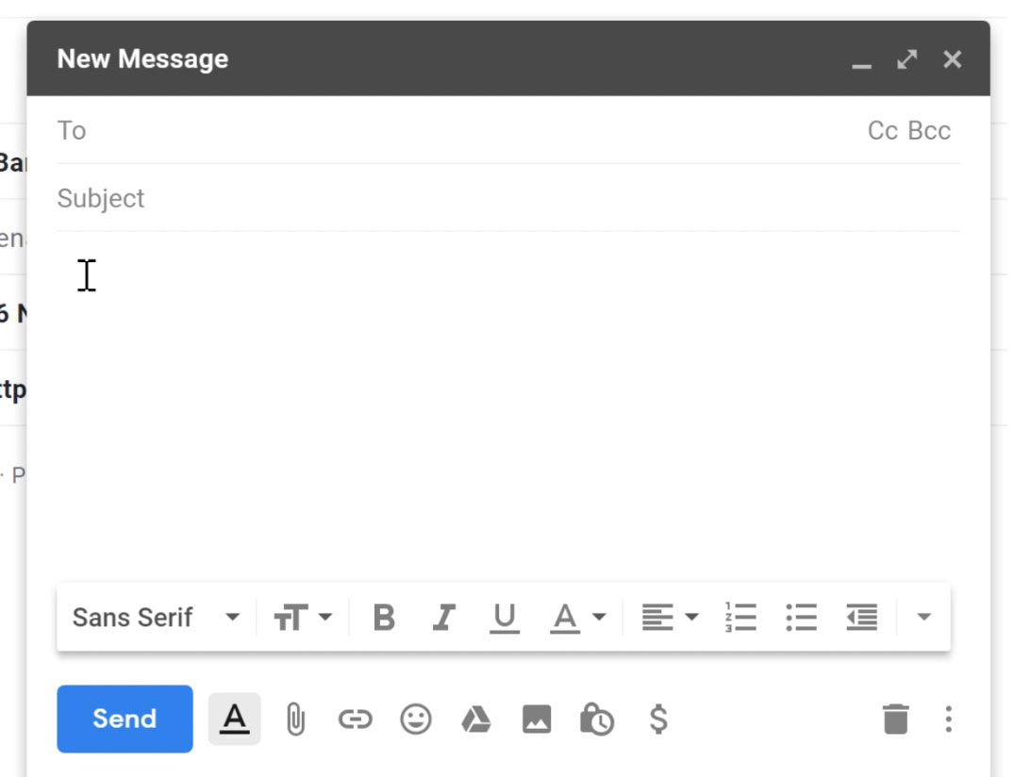

Data model v. 2
Current Process
REVISION
revID*
revNum
revDate
revUpdate
ncrID#
Cluttered information
Hard to follow and No Ease of Access
Make the computer slower, taking more memory space
Too many separate processes (NCR, Sharing, etc.)
High time consumption
REVISIONLOG
revLogID*
revID#
>
ROLE
SALE
saleID*
salesOrderReceiptNum
REVIEWENGINEER
reviewEngID*
reviewDisposition
reviewCustUpdate
engInsID#
NCRENGINEERINSPECTOR
engInspID*
engDisposition
>
PRODUCT_ORDER
orderID*
orderProductNo
orderProductQuantity
prodID#
saleID#
PRODUCT
prodID*
prodNo
prodDescription
supplierID#
ROLE
roleID*
roleType
>
ALEX ARMANI
>
CROSSFIRE EMPLOYEE
QUALITY Rep
>
>
EMPLOYEE
empID*
empName
roleID
ROLEINCHARGE
roleChargeID*
roleID#
NCRQUALITYREP
qRepID*
ncrFormConfirm
ncrIdentityProcess
ncrDefectDescription
ncrQuantityDefective
ncrID#
NCR
ncrID*
ncrDate
ncrLogNumber
ncrActive
orderID#
>
>
SUPPLIER
supplierID*
supplierName
ncrLogNum#
EMPLOYEEINCHARGE
empChargeID*
empSign
empSignDate
empID#
ncrID#
Project: OSS-NCR
Presentation Content: Data Model Revision and Insight of NCR process.
Introduction

Slide 11

Data model v. 2
Current Process
REVISION
revID*
revNum
revDate
revUpdate
ncrID#
Cluttered information
Hard to follow and No Ease of Access
Make the computer slower, taking more memory space
Too many separate processes (NCR, Sharing, etc.)
High time consumption
REVISIONLOG
revLogID*
revID#
>
ROLE
SALE
saleID*
salesOrderReceiptNum
REVIEWENGINEER
reviewEngID*
reviewDisposition
reviewCustUpdate
engInsID#
NCRENGINEERINSPECTOR
engInspID*
engDisposition
>
PRODUCT_ORDER
orderID*
orderProductNo
orderProductQuantity
prodID#
saleID#
PRODUCT
prodID*
prodNo
prodDescription
supplierID#
ROLE
roleID*
roleType
>
ALEX ARMANI
>
CROSSFIRE EMPLOYEE
QUALITY Rep
>
>
EMPLOYEE
empID*
empName
roleID
ROLEINCHARGE
roleChargeID*
roleID#
NCRQUALITYREP
qRepID*
ncrFormConfirm
ncrIdentityProcess
ncrDefectDescription
ncrQuantityDefective
ncrID#
NCR
ncrID*
ncrDate
ncrLogNumber
ncrActive
orderID#
>
>
SUPPLIER
supplierID*
supplierName
ncrLogNum#
EMPLOYEEINCHARGE
empChargeID*
empSign
empSignDate
empID#
ncrID#
Project: OSS-NCR
Presentation Content: Data Model Revision and Insight of NCR process.
Introduction

Slide 12
Data model v. 2
Current Process
REVISION
revID*
revNum
revDate
revUpdate
ncrID#
REVISIONLOG
revLogID*
revID#
>
ROLE
SALE
saleID*
salesOrderReceiptNum
REVIEWENGINEER
reviewEngID*
reviewDisposition
reviewCustUpdate
engInsID#
NCRENGINEERINSPECTOR
engInspID*
engDisposition
>
PRODUCT_ORDER
orderID*
orderProductNo
orderProductQuantity
prodID#
saleID#
PRODUCT
prodID*
prodNo
prodDescription
supplierID#
ROLE
roleID*
roleType
>
ALEX ARMANI
>
CROSSFIRE EMPLOYEE
QUALITY Rep
>
>
EMPLOYEE
empID*
empName
roleID
ROLEINCHARGE
roleChargeID*
roleID#
NCRQUALITYREP
qRepID*
ncrFormConfirm
ncrIdentityProcess
ncrDefectDescription
ncrQuantityDefective
ncrID#
NCR
ncrID*
ncrDate
ncrLogNumber
ncrActive
orderID#
>
>
SUPPLIER
supplierID*
supplierName
ncrLogNum#
EMPLOYEEINCHARGE
empChargeID*
empSign
empSignDate
empID#
ncrID#
Project: OSS-NCR
Presentation Content: Data Model Revision and Insight of NCR process.
Introduction

Slide 13
Data model v. 2
OUR GOAL
REVISION
revID*
revNum
revDate
revUpdate
ncrID#
REVISIONLOG
revLogID*
revID#
>
ROLE
SALE
saleID*
salesOrderReceiptNum
REVIEWENGINEER
reviewEngID*
reviewDisposition
reviewCustUpdate
engInsID#
NCRENGINEERINSPECTOR
engInspID*
engDisposition
Less time consumption
and More efficiency
All in One record
generating and
keeping platform
>
PRODUCT_ORDER
orderID*
orderProductNo
orderProductQuantity
prodID#
saleID#
Here’s how it looks!
PRODUCT
prodID*
prodNo
prodDescription
supplierID#
ROLE
roleID*
roleType
>
ALEX ARMANI
>
Simplicity
and
Accessibility
Reducing reliance
on Excel
CROSSFIRE EMPLOYEE
QUALITY Rep
>
>
EMPLOYEE
empID*
empName
roleID
ROLEINCHARGE
roleChargeID*
roleID#
NCRQUALITYREP
qRepID*
ncrFormConfirm
ncrIdentityProcess
ncrDefectDescription
ncrQuantityDefective
ncrID#
NCR
ncrID*
ncrDate
ncrLogNumber
ncrActive
orderID#
>
>
SUPPLIER
supplierID*
supplierName
ncrLogNum#
EMPLOYEEINCHARGE
empChargeID*
empSign
empSignDate
empID#
ncrID#
Project: OSS-NCR
Presentation Content: Data Model Revision and Insight of NCR process.
Introduction

Slide 14
Data model v. 2
OUR GOAL
REVISION
revID*
revNum
revDate
revUpdate
ncrID#
REVISIONLOG
revLogID*
revID#
>
ROLE
SALE
saleID*
salesOrderReceiptNum
REVIEWENGINEER
reviewEngID*
reviewDisposition
reviewCustUpdate
engInsID#
NCRENGINEERINSPECTOR
engInspID*
engDisposition
Less time consumption
and More efficiency
All in One record
generating and
keeping platform
>
PRODUCT_ORDER
orderID*
orderProductNo
orderProductQuantity
prodID#
saleID#
Here’s how it looks!
PRODUCT
prodID*
prodNo
prodDescription
supplierID#
ROLE
roleID*
roleType
>
ALEX ARMANI
>
Simplicity
and
Accessibility
Reducing reliance
on Excel
CROSSFIRE EMPLOYEE
QUALITY Rep
>
>
EMPLOYEE
empID*
empName
roleID
ROLEINCHARGE
roleChargeID*
roleID#
NCRQUALITYREP
qRepID*
ncrFormConfirm
ncrIdentityProcess
ncrDefectDescription
ncrQuantityDefective
ncrID#
NCR
ncrID*
ncrDate
ncrLogNumber
ncrActive
orderID#
>
>
SUPPLIER
supplierID*
supplierName
ncrLogNum#
EMPLOYEEINCHARGE
empChargeID*
empSign
empSignDate
empID#
ncrID#
Project: OSS-NCR
Presentation Content: Data Model Revision and Insight of NCR process.
Introduction

Slide 15
Data model v. 2
OUR GOAL
REVISION
revID*
revNum
revDate
revUpdate
ncrID#
REVISIONLOG
revLogID*
revID#
>
ROLE
SALE
saleID*
salesOrderReceiptNum
REVIEWENGINEER
reviewEngID*
reviewDisposition
reviewCustUpdate
engInsID#
NCRENGINEERINSPECTOR
engInspID*
engDisposition
Less time consumption
and More efficiency
All in One record
generating and
keeping platform
>
PRODUCT_ORDER
orderID*
orderProductNo
orderProductQuantity
prodID#
saleID#
Here’s how it looks!
PRODUCT
prodID*
prodNo
prodDescription
supplierID#
ROLE
roleID*
roleType
>
ALEX ARMANI
>
Simplicity
and
Accessibility
Reducing reliance
on Excel
CROSSFIRE EMPLOYEE
QUALITY Rep
>
>
EMPLOYEE
empID*
empName
roleID
ROLEINCHARGE
roleChargeID*
roleID#
NCRQUALITYREP
qRepID*
ncrFormConfirm
ncrIdentityProcess
ncrDefectDescription
ncrQuantityDefective
ncrID#
NCR
ncrID*
ncrDate
ncrLogNumber
ncrActive
orderID#
>
>
SUPPLIER
supplierID*
supplierName
ncrLogNum#
EMPLOYEEINCHARGE
empChargeID*
empSign
empSignDate
empID#
ncrID#
Project: OSS-NCR
Presentation Content: Data Model Revision and Insight of NCR process.
Introduction

Slide 16
Data model v. 2
OUR GOAL
REVISION
revID*
revNum
revDate
revUpdate
ncrID#
REVISIONLOG
revLogID*
revID#
>
ROLE
SALE
saleID*
salesOrderReceiptNum
REVIEWENGINEER
reviewEngID*
reviewDisposition
reviewCustUpdate
engInsID#
NCRENGINEERINSPECTOR
engInspID*
engDisposition
Less time consumption
and More efficiency
All in One record
generating and
keeping platform
>
PRODUCT_ORDER
orderID*
orderProductNo
orderProductQuantity
prodID#
saleID#
Here’s how it looks!
PRODUCT
prodID*
prodNo
prodDescription
supplierID#
ROLE
roleID*
roleType
>
ALEX ARMANI
>
CROSSFIRE EMPLOYEE
Simplicity
and
Accessibility
Reducing reliance
on Excel
QUALITY Rep
>
>
EMPLOYEE
empID*
empName
roleID
ROLEINCHARGE
roleChargeID*
roleID#
NCRQUALITYREP
qRepID*
ncrFormConfirm
ncrIdentityProcess
ncrDefectDescription
ncrQuantityDefective
ncrID#
NCR
ncrID*
ncrDate
ncrLogNumber
ncrActive
orderID#
>
>
SUPPLIER
supplierID*
supplierName
ncrLogNum#
EMPLOYEEINCHARGE
empChargeID*
empSign
empSignDate
empID#
ncrID#
Project: OSS-NCR
Presentation Content: Data Model Revision and Insight of NCR process.
Introduction

Slide 17
Data model v. 2
OUR GOAL
REVISION
revID*
revNum
revDate
revUpdate
ncrID#
REVISIONLOG
revLogID*
revID#
>
ROLE
SALE
saleID*
salesOrderReceiptNum
REVIEWENGINEER
reviewEngID*
reviewDisposition
reviewCustUpdate
engInsID#
NCRENGINEERINSPECTOR
engInspID*
engDisposition
Less time consumption
and More efficiency
All in One record
generating and
keeping platform
>
PRODUCT_ORDER
orderID*
orderProductNo
orderProductQuantity
prodID#
saleID#
Here’s how it looks!
PRODUCT
prodID*
prodNo
prodDescription
supplierID#
ROLE
roleID*
roleType
>
ALEX ARMANI
>
CROSSFIRE EMPLOYEE
Simplicity
and
Accessibility
Reducing reliance
on Excel
QUALITY Rep
>
>
EMPLOYEE
empID*
empName
roleID
ROLEINCHARGE
roleChargeID*
roleID#
NCRQUALITYREP
qRepID*
ncrFormConfirm
ncrIdentityProcess
ncrDefectDescription
ncrQuantityDefective
ncrID#
NCR
ncrID*
ncrDate
ncrLogNumber
ncrActive
orderID#
>
>
SUPPLIER
supplierID*
supplierName
ncrLogNum#
EMPLOYEEINCHARGE
empChargeID*
empSign
empSignDate
empID#
ncrID#
Project: OSS-NCR
Presentation Content: Data Model Revision and Insight of NCR process.
Introduction

Slide 18
Data model v. 2
OUR GOAL
REVISION
revID*
revNum
revDate
revUpdate
ncrID#
REVISIONLOG
revLogID*
revID#
>
ROLE
SALE
saleID*
salesOrderReceiptNum
REVIEWENGINEER
reviewEngID*
reviewDisposition
reviewCustUpdate
engInsID#
NCRENGINEERINSPECTOR
engInspID*
engDisposition
Less time consumption
and More efficiency
All in One record
generating and
keeping platform
>
PRODUCT_ORDER
orderID*
orderProductNo
orderProductQuantity
prodID#
saleID#
Here’s how it looks!
PRODUCT
prodID*
prodNo
prodDescription
supplierID#
ROLE
roleID*
roleType
>
ALEX ARMANI
>
CROSSFIRE EMPLOYEE
Simplicity
and
Accessibility
Reducing reliance
on Excel
QUALITY Rep
>
>
EMPLOYEE
empID*
empName
roleID
ROLEINCHARGE
roleChargeID*
roleID#
NCRQUALITYREP
qRepID*
ncrFormConfirm
ncrIdentityProcess
ncrDefectDescription
ncrQuantityDefective
ncrID#
NCR
ncrID*
ncrDate
ncrLogNumber
ncrActive
orderID#
>
>
SUPPLIER
supplierID*
supplierName
ncrLogNum#
EMPLOYEEINCHARGE
empChargeID*
empSign
empSignDate
empID#
ncrID#
Project: OSS-NCR
Presentation Content: Data Model Revision and Insight of NCR process.
Introduction

